Slide 1
Face AI APPLICATION

Slide 2
Agenda
Definition
Advantages
Use Cases
Methodology (Approach)
System context diagram
Work Flow Diagram

Slide 3
Definition
A facial recognition attendance system incorporates facial recognition technology to recognize and verify an employee's facial features and to record attendance automatically.

Slide 4
Advantages
Better security
Easy Integration
Automated Identification
Avoid Fraud Attendance
Time-Saving

Slide 5
Use Cases
Workplace
Education
Healthcare
Events
Security

Slide 6
Methodology Waterfall model is a sequential approach, Where each fundamental activity of a process represented as a separate phase, arranged in liner order.
Requirement
Requirement Doc’s
Prepare Use Cases
Design
Software Architecture
Implementation
Construct the software
Data storage & Retrieval
Verification
Install
Test &Debug
Maintenance
Check errors
Optimize capabilities

Slide 7
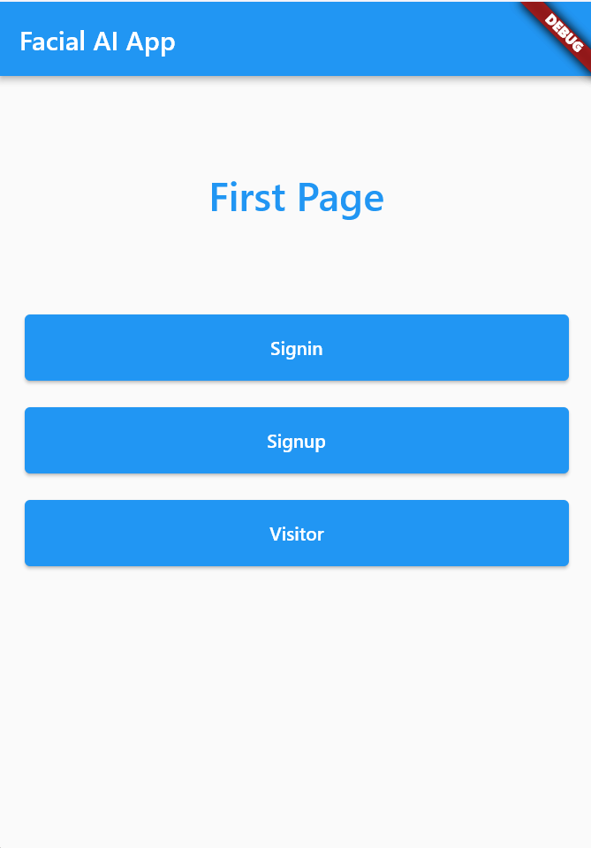
Home Button

Slide 8

Signup -- capturing images

Slide 9
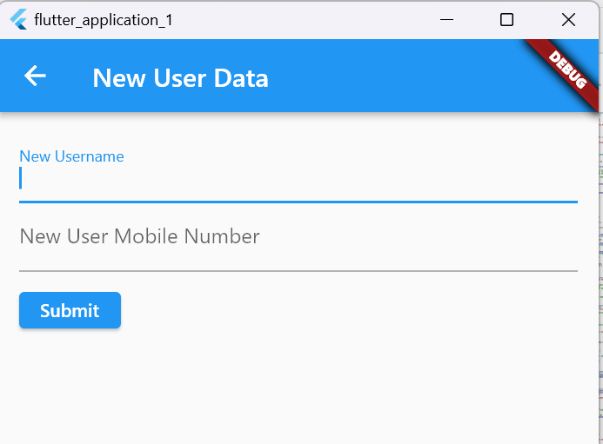
Signup--Request Form

Slide 10
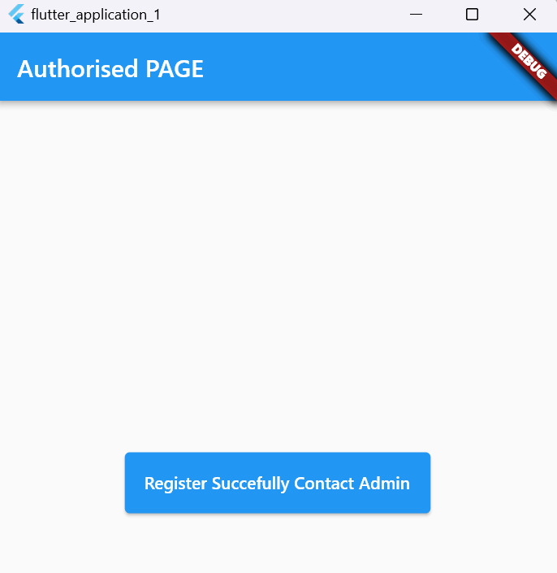
Signup--Registered Successfully

Slide 11
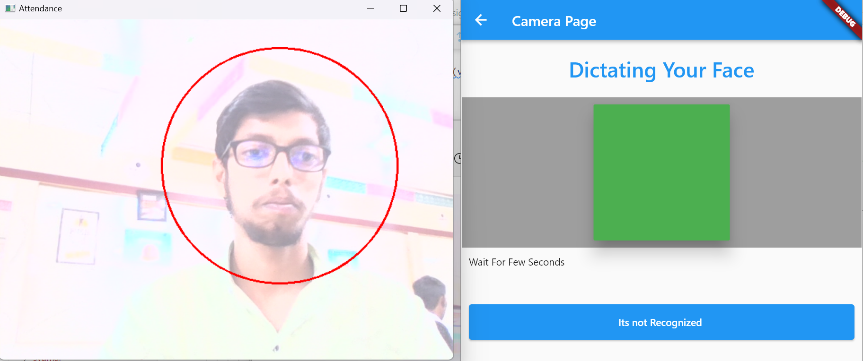
Sign in - Button

Slide 12
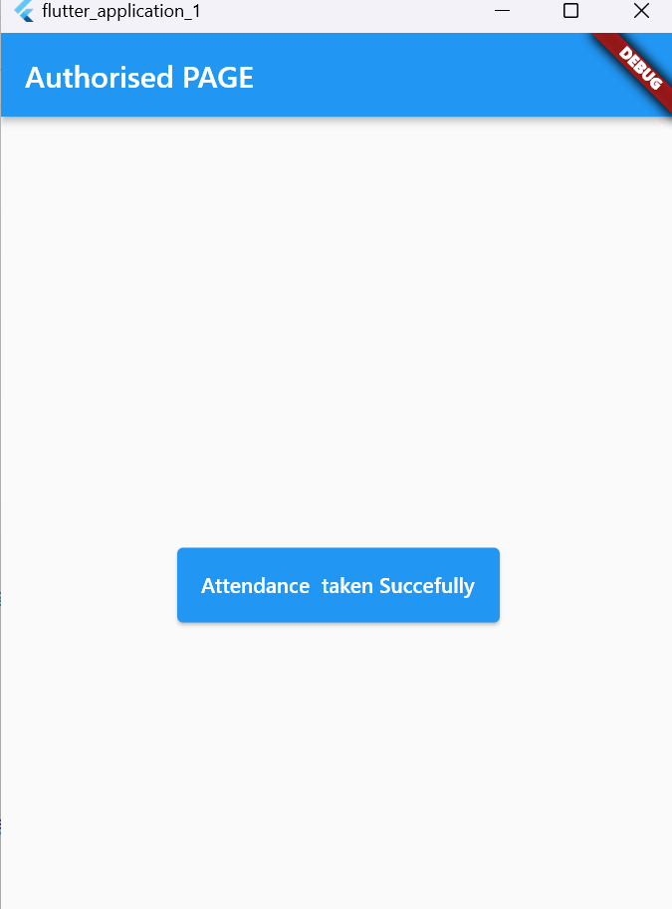
Sign in – Authorized

Slide 13
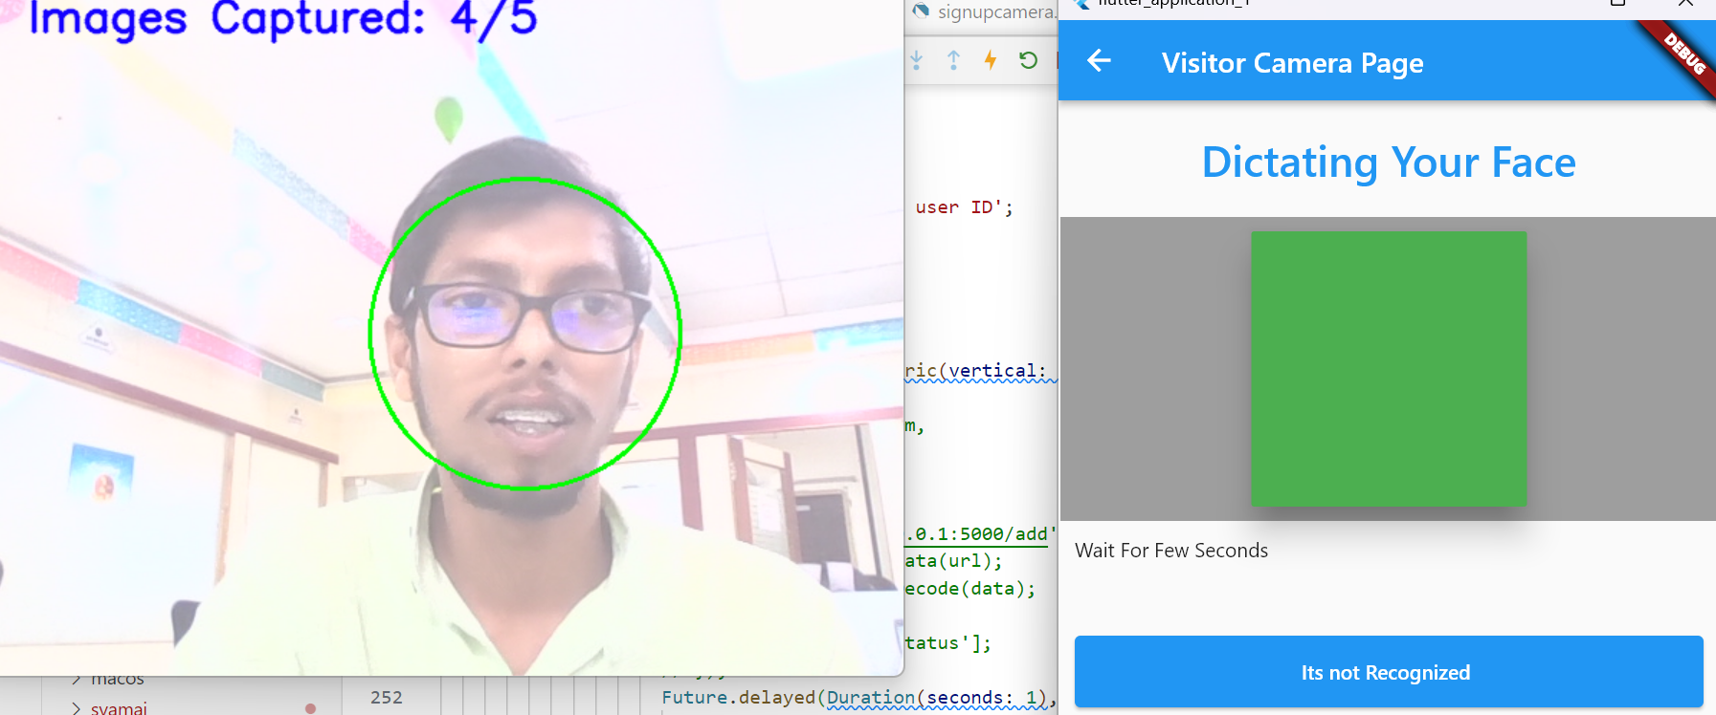
Visitor– Capturing Images

Slide 14
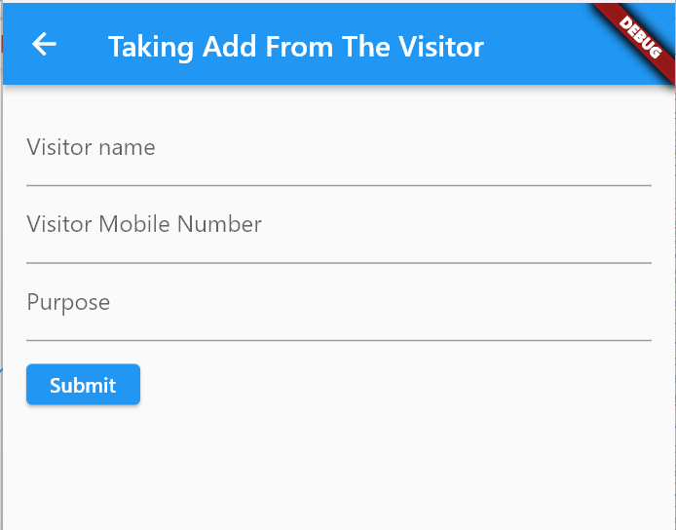
Visitor-- Request form

Slide 15
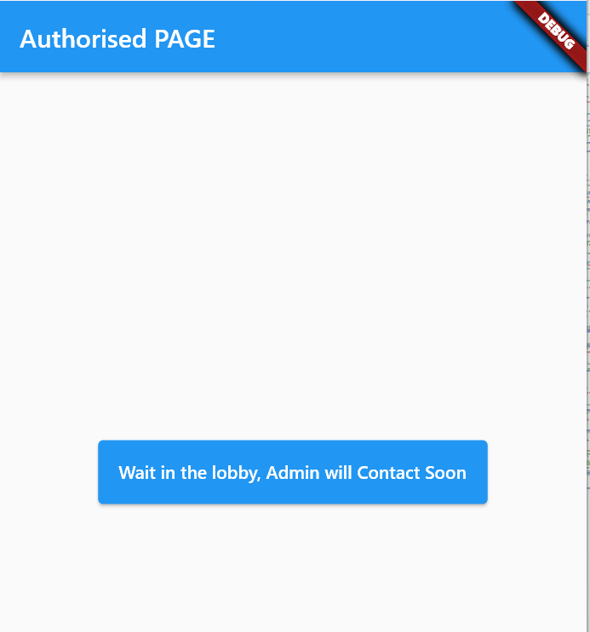
Visitor -- Wait in Lobby

Slide 16
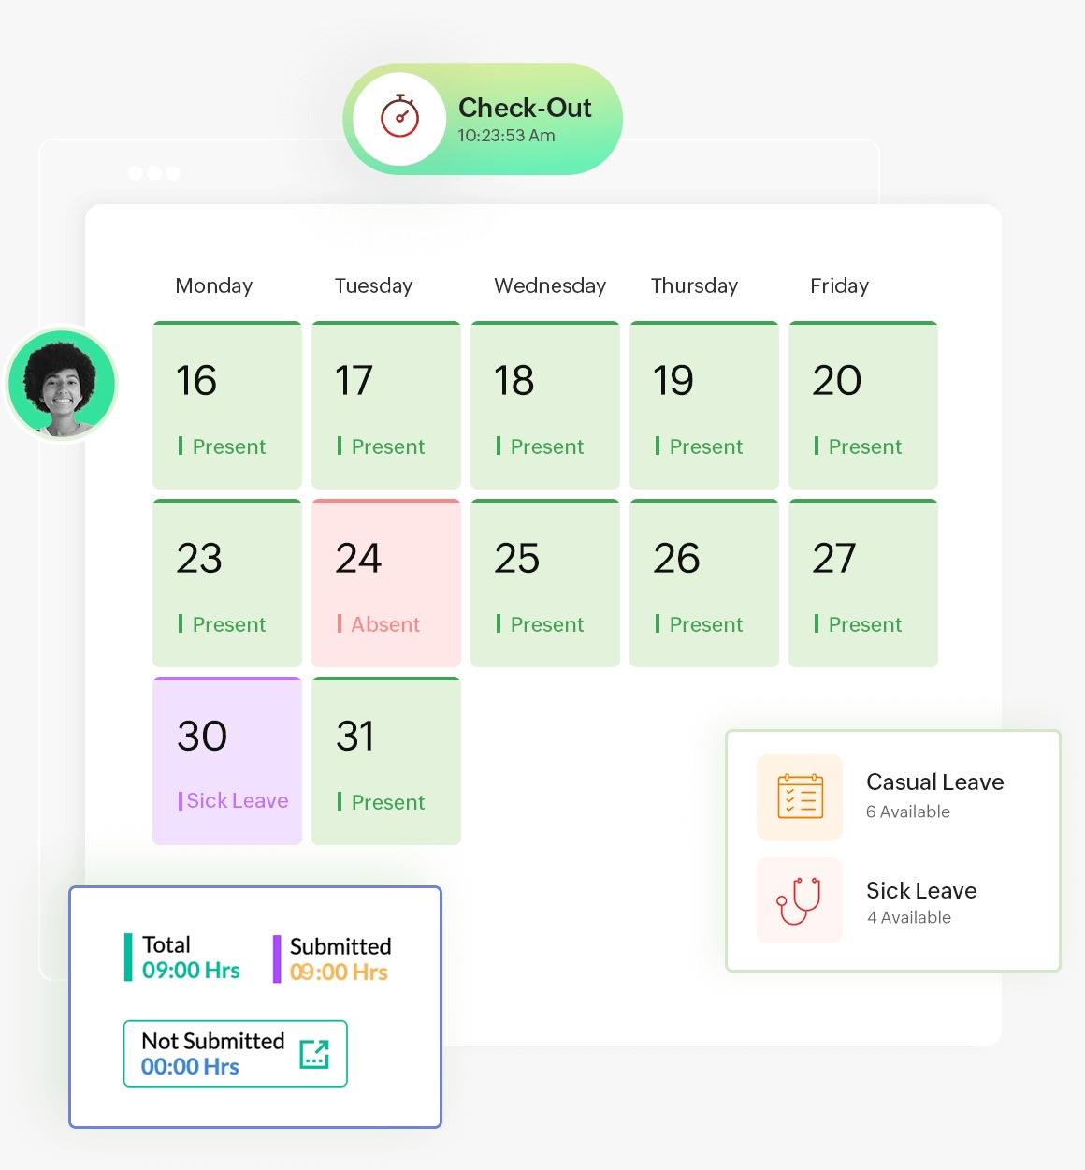
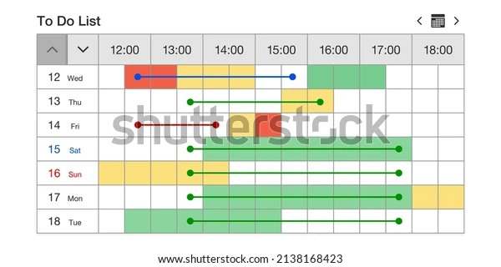
Calendar Based Attendance System

Slide 17
Thank you

